Slide 1
Company Name: CarryCrafter
MOTTO: Carry All Thing
Project Title: BAG WITH AN EXTRA FOOD COMPARTMENT
S.No | Name of the student | Year/Dept. | Email Id
1 | ABISHEK A | ^{2rd} yr/ECE | abishekarumugam8@gmail.com
2 | BALAJI K | ^{2rd} yr/ECE | balajikalidoss2005@gmail.com
3 | CHOCKALINGAM R.D | ^{2rd} yr/ECE | chockalingam4646@gmail.com
4 | DHAUSH R | ^{2rd} yr/ECE | dhanushrajendran@gmail.com

Slide 2

BAG WITH AN EXTRA FOOD COMPARTMENT
ABISHEK.A
BALAJI K
CHOCKALINGAM R.D
DHANUSH R

Slide 3
Problem Statement
Carrying multiple items like lunch boxes, gadgets, or small essentials in traditional backpacks is inconvenient due to insufficient storage or poorly designed compartments. Users need a functional, durable, and stylish bag that offers extra, easily accessible storage while maintaining comfort and aesthetics.

Slide 4
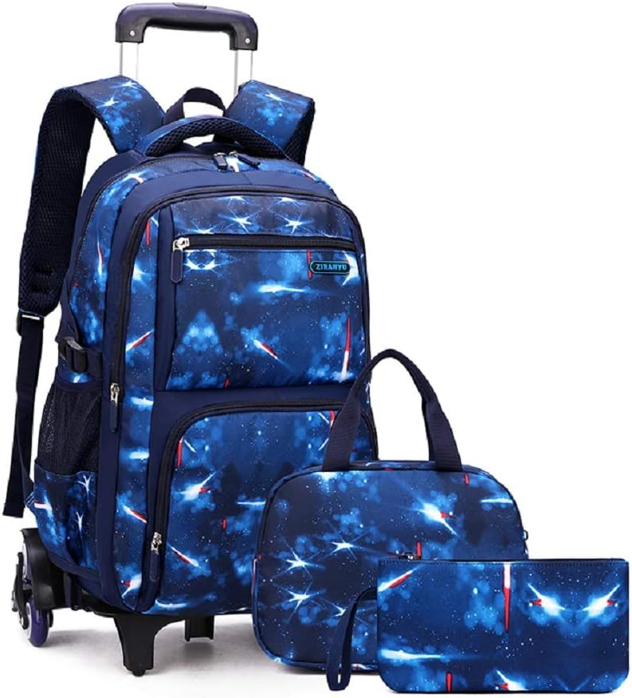
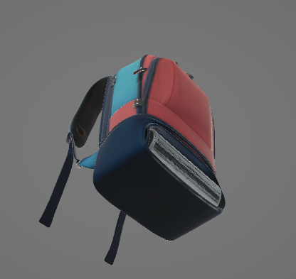

Existing Product Detail

Slide 5
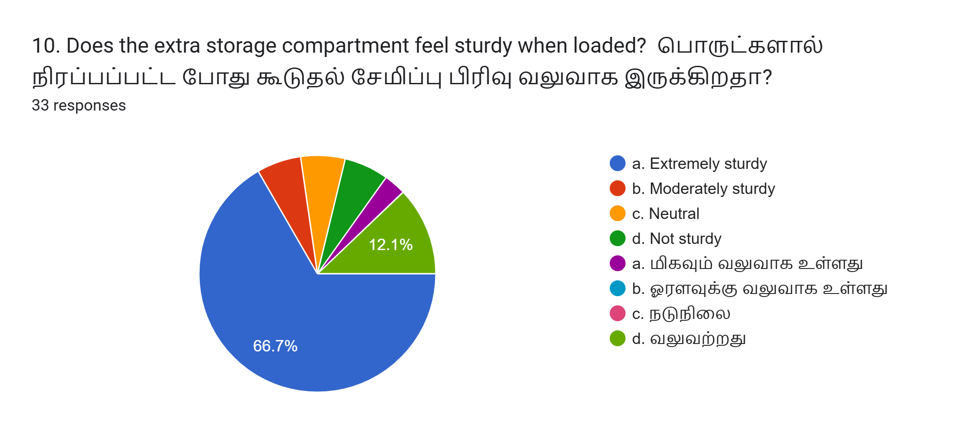
HIGHLIGHTED SURVEY REPORT

Slide 6
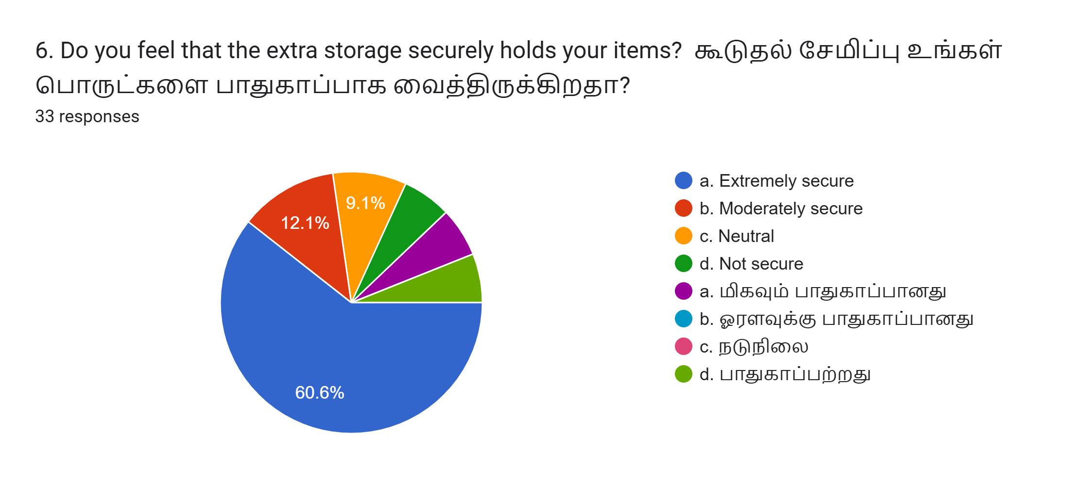

Slide 7
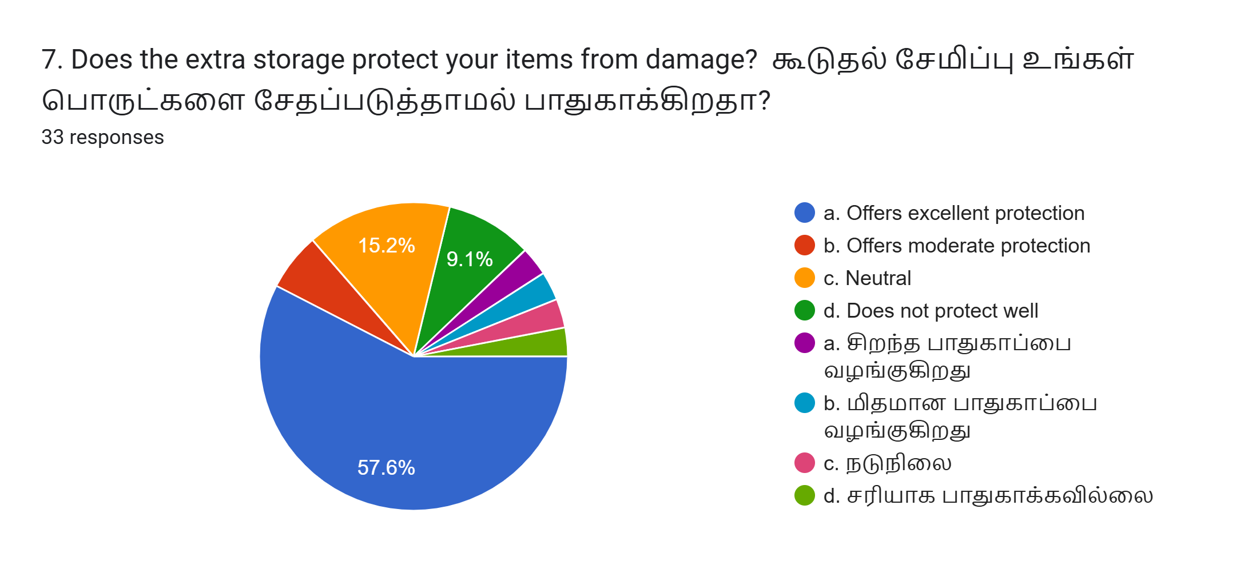

Slide 8
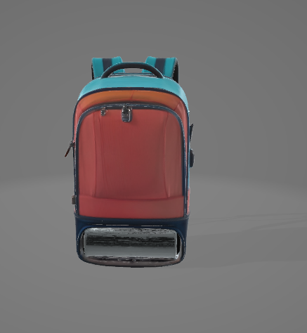
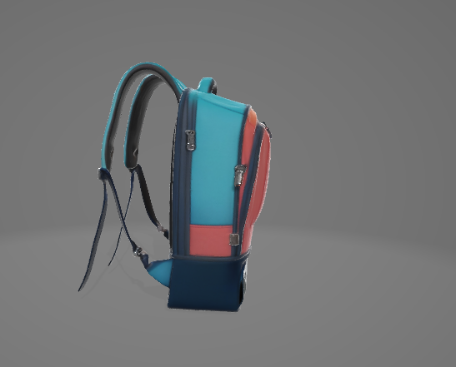
Solution (Or) Proposed Design

Slide 9
Working Of Invention

Slide 10
Target Marketing
Students: Need space for books, stationery, and lunch boxes.
Professionals: Require organized storage for gadgets and meals.
Travelers: Seek compact, multi-functional bags for short trips.
Parents: Look for practical and durable bags for kids.

Slide 11
Competitor Analysis
Key Competitors:
Standard backpack brands (e.g., Wildcraft, American Tourister).
Specialized storage bags like laptop or travel backpacks.
Weaknesses in Competitors:
Limited focus on extra, dedicated storage compartments.
Often bulky or compromise aesthetics for functionality.
Our Competitive Edge:
Stylish design with added storage for small items.
Affordable price without compromising on quality or durability.

Slide 12
My Solution Product
Compact and Portable: Smaller size, ideal for households or small businesses.
Manual Operation: No need for electricity, making it eco-friendly and cost-effective.
Affordable: Lower manufacturing and retail costs compared to industrial competitors.
Simple Maintenance: Easy to repair

Slide 13
Value Proportion
Functional Design: Extra storage for lunch or small items without disrupting the bag's overall structure.
Durability: High-quality materials for daily usage.
Aesthetics: A sleek and stylish design that appeals to students and professionals alike.
Affordability: High value at a competitive price.

Slide 14
Channels For Marketing
Online Platforms: E-commerce websites, social media advertising, and the brand’s official website.
Retail Stores: Partnerships with stores specializing in bags and travel accessories.
Promotional Campaigns: Social media influencers and targeted advertisements.
Exhibitions and Trade Shows: Featuring the bag in lifestyle and travel expos.

Slide 15
Revenue Model
Direct Sales
Wholesale Partnerships
Customized Products
Accessory Sales
Subscription Services
Seasonal and Limited-Edition Launches
Collaborations and Sponsorships
Repair and Maintenance Services

Slide 16
MARKETING STATERGY
Market Analysis
Target Market:
Students, professionals, travelers, and parents.
Market Trends:
Demand for stylish, functional, eco-friendly bags.
Competitor Landscape:
General-purpose backpacks dominate the market.
Market Opportunities:
Specialized bags with extra storage for small items.
Product Positioning
Core Message:
"Stylish and functional with extra storage."
USP:
Extra storage for lunch boxes and small items.
Price Positioning:
Affordable, mid-range pricing.
Brand Identity:
Modern, functional, customer-focused.

Slide 17
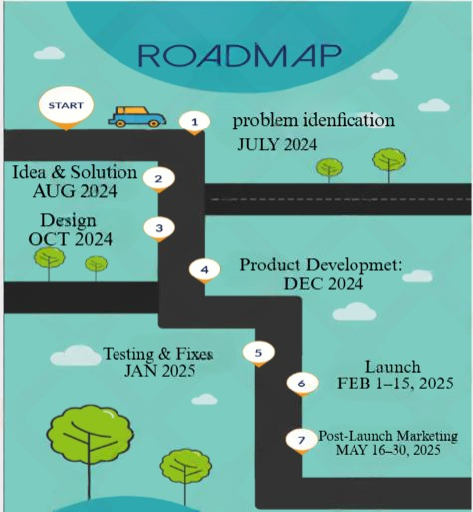
ROAD MAP

Slide 18
THANK YOU!

